Slide 1
AI Marketing Strategy Manager
Multi-Agent Marketing Strategy Platform using OpenAI Agents SDK
Python | OpenAI Agents SDK | Gradio
Business Input
AI Agents
Marketing Strategy
Human Approval
Analytics

Slide 2
Problem Analysis
Business context and motivation
Modern marketing requires:
Why a multi-agent system?
• Market research
• Competitor analysis
• Campaign planning
• Content strategy
• Marketing optimization
• Campaign performance analysis
Managing these tasks separately requires time, coordination, and specialized marketing expertise.
Traditional
Manual Tasks
Separate Analysis
Manual Strategy
AI-based
Business Input
AI Agents
Unified Strategy

Slide 3
Stakeholders & Project Objectives
Stakeholders
Objectives
• Business owners
• Marketing managers
• Marketing teams
• Campaign managers
• Content teams
• Decision makers
• Automate major marketing strategy tasks
• Use specialized AI agents
• Coordinate outputs between workflow stages
• Generate structured marketing strategies
• Maintain business context
• Analyze campaign performance
• Keep human approval before saving

Slide 4
Multi-Agent System Architecture
USER
Content Strategist Agent
Analytics Flow
Gradio Interface
Optimization Advisor Agent
Campaign Data
Analytics Agent
Report
Marketing Workflow
Marketing Manager
Market Research Agent
Final Strategy
Supporting Components
Competitor Analysis Agent
Human Approval
research.py
budget.py
memory.py
Campaign Planner Agent
Saved Report
report.py
analytics.py
memory.json

Slide 5
Specialized AI Agents
Focused roles for each marketing task
Market Research
Competitor Analysis
Campaign Planner
Target market, needs, trends, opportunities
Competitors, strengths, weaknesses, positioning
Objectives, channels, budget, KPIs
Content Strategist
Optimization Advisor
Analytics Agent
Content ideas, messaging, channel strategy
Reviews strategy and recommends improvements
Campaign performance data and recommendations
Marketing Manager
Combines specialist outputs into final strategy

Slide 6
Agent Interaction & Workflow
Sequential workflow coordination and context passing
Business Information
Market Research
Competitor Analysis
Campaign Planning
Content Strategy
Optimization
Marketing Manager
Final Strategy
Human Approval
How context moves through the system
Each agent performs a focused marketing task. Relevant outputs from earlier stages are used as context for subsequent stages. The Marketing Manager consolidates the specialist outputs into the final strategy.

Slide 7
Tools & Technology Integration
Component
Purpose
research.py
Research-related operations
budget.py
Marketing budget calculations and validation
memory.py
Business/context storage and retrieval
report.py
Marketing report generation and saving
analytics.py
Campaign performance calculations
memory.json
Persistent business/context storage
Python
Core programming language
OpenAI Agents SDK
Agent implementation and workflow coordination
Gradio
Interactive web interface

Slide 8
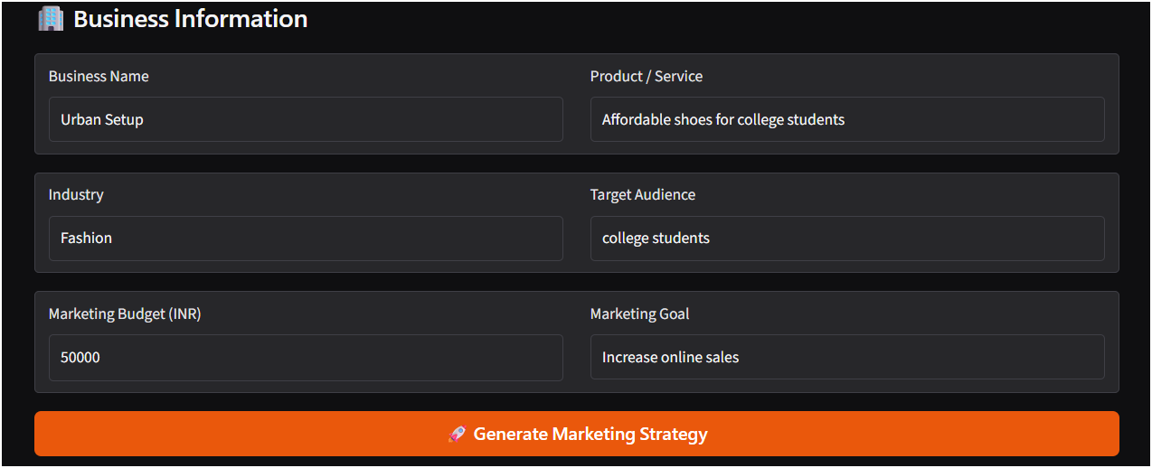
How the Application Works
From business input to approved marketing strategy
1. Enter business information
2. Provide audience, budget & goal
3. Specialized agents process input
4. Marketing Manager creates strategy
5. Strategy displayed in Gradio
6. User reviews strategy
7. Click Approve Strategy
8. Approved report is saved
Example strategy sections
• Executive Summary • Target Audience • Customer Needs • Market Opportunities
• Competitor Analysis • Brand Positioning • Campaign Objective
• Marketing Channels • Budget Allocation • Content Strategy • KPIs • Optimization
U

Slide 9
Human Approval & Campaign Analytics
Human Approval
Campaign Analytics
Inputs
Outputs
AI Agents
• Impressions
• Clicks
• Conversions
• Ad Cost
• Revenue
• CTR
• Conversion Rate
• Cost / Conversion
• ROAS
• Performance Analysis
• Recommendations
Final Strategy
User Review
Approve Strategy
Saved Report
Campaign Data
Analytics Agent
Report

Slide 10
Project Results & Conclusion
Implemented capabilities
Conclusion
✓ Multiple specialized AI agents
✓ Market research & competitor analysis
✓ Campaign planning & content strategy
✓ Optimization recommendations
✓ Campaign analytics
✓ Memory/context management
✓ Structured outputs
✓ Human approval
✓ Gradio interface
✓ Report saving
The AI Marketing Strategy Manager demonstrates how specialized AI agents can work within a coordinated workflow to transform business information into a structured marketing strategy.
The platform supports the process from business input and strategy generation to human approval and campaign performance analysis.
Business Input
AI Marketing Agents
Marketing Strategy
Human Approval
Analytics

